Slide 1
GRAYLOG OPERATIONS A Powerful, Flexible, and Seamless Centralized Log Management Experience
LOG MANAGEMENT DONE RIGHT.

Slide 2
Visibility into IT issues is becoming more difficult as modern IT environments continue to grow, in size and complexity, while applications, systems, and devices across the network produce larger amounts of log data.
INTRODUCTION TO GRAYLOG OPERATIONS
Notes:
Manual and legacy approaches to log collection, normalization, and analysis scale poorly, so organizations need a better way to collect and analyze large volumes of log data without creating a heavy burden on IT professionals.

Slide 3



Why do IT organizations deploy CLMs?
Centralized log data
Increased visibility into IT performance
Intelligent alerting
INTRODUCTION TO GRAYLOG OPERATIONS
Notes:
What problems are log management solutions supposed to solve?
Collect event log data from across the entire IT environment into one place can increase your awareness of what’s going on in your environment, and the data can be analyzed and turned into information that can help detect and respond to performance issues - especially those that require combining data from multiple systems to identify
Firewalls, applications, and servers are always running and working, and there is a lot going on at any given moment. That is why it is important to stay on top of new errors when they are first introduced into the system. Manually sifting through log files will result in a retroactive perspective of what happened. Timing is everything and getting alerts in real-time is a critical component of fixing issues before they severely impact your users or environment

Slide 4
Instead, they usually end up with…
INABILITY TO SCALE
COMPLEXITY
MANUAL OPERATIONS
HALF IMPLEMENTATIONS
HIGH COSTS
ALERT FATIGUE
INTRODUCTION TO GRAYLOG OPERATIONS
Notes:
The reality for most organizations is an entirely different story . . .
Legacy log management solutions have been difficult to implement, requiring a lot of professional services hours, expensive dedicated certified operators, and a lot of manual workarounds resulting in many failed or partial implementations that don’t deliver on the promise of the solution
Vendors worked to address many of the implementation issues through pre-built alerting rules and dashboards, but fear of missing something important resulted in turning on all the rules and creating alert fatigue
The complexity, rigidity, and slowness of legacy log management solutions has also created operations burnout, making staffing even more difficult in today’s extremely competitive job market
And finally, just the base license cost alone has caused organizations to not collect data they would otherwise include, meaning there’s a lack of visibility across the entire IT environment

Slide 5
GRAYLOG OPERATIONS IS DESIGNED TO SIMPLIFY IT PERFORMANCE ANALYSIS AND DELIVER ON THE PROMISE OF LOG MANAGEMENT
INTRODUCTION TO GRAYLOG OPERATIONS
Notes:
Graylog Operations is a powerful, easy-to-use, log management and analysis solution designed to provide IT professionals with increased visibility into activity occurring within their infrastructure. Graylog Operations can help make IT professionals’ jobs easier and faster by collecting and normalizing event logs generated across your entire on-prem, hybrid, or cloud environment into a centralized location, and automatically correlating events for real-time analysis without requiring you to scan logs manually.

Slide 6
Graylog Operations includes…
Self-managed or cloud experience
Centralized log storage and archival of historic data
Universal data source ingestion (custom apps, less common COTS apps, old/unsupported legacy apps)
Lightning-fast investigations
Automated log data normalization and event correlation
Customizable alert engine
Out-of-the-box dashboards, alerts, and search filters
Report creation and delivery scheduler
Ready-to-use configs for Graylog Sidecar
UI for creating and editing pipeline rules
INTRODUCTION TO GRAYLOG OPERATIONS
Notes:
Graylog Operations delivers the core functionality you need to do what a centralized log management solution is supposed to do.
Graylog Operations automatically normalizes data so that it can be easily correlated, enriched, and flow into existing dashboards, alerts, and reports. It also makes it much easier to build complex searches and analyze data across multiple sources that structure and name data differently
Nowhere does Graylog Operations shine more than when it comes to investigating IT performance issues. There’s a world of difference between using a proprietary query language to code rigid data queries that require you to know what you are looking for while waiting for hours - sometimes days - for results vs. Graylog’s user-friendly UI that allows you to explore the data, flowing from one view to the next with near-instant results and infinite reusability
So now let’s explore a few of these areas so you can see what Graylog Operations has to offer.

Slide 7



Easily adaptable to your environment
Experience Graylog Operations your way
Delivered in a self-managed or cloud experience
Ingest any log source from anywhere
Simple data parsing and enrichment
INTRODUCTION TO GRAYLOG OPERATIONS
Notes:
Of course, all of this great functionality is only useful if it works in your environment.
Graylog Operations does not limit you to a specific deployment model. If you are more comfortable managing your onsite data, you can deploy Graylog Operations on-premises. If you are familiar with cloud applications and are comfortable with your data being stored in the cloud, Graylog Operations can be deployed as a cloud experience.
We also don’t limit you to data sources explicitly supported by us. Through a variety of mechanisms such as our REST API and centralized management of common data shippers (data pushed into Graylog), Graylog Operations can consume data from syslog, CEF, raw / plaintext files, JSON, GELF (Graylog Extended Log Format), Beats collectors, and CSV/Excel.
Graylog Operations is built to be part of an open ecosystem and is also designed to provide you with complete, and easy to configure control over how data is structured and what data is sent for export. Data is easily formatted to meet the needs of the receiving system through their API or ours, or using any of the common data shippers, in all the expected formats such as GELF, CSV/Excel, PDF, PNG, or JSON. This makes it easy to get data in AND out of Graylog Operations through either push or pull methods - whatever works best for you.

Slide 8


Intuitive and approachable UI
Designed for IT detecting and resolving IT performance issues
Day- and night-mode options
Built-in search templates and filters
Powerful alerting and event correlation engines
INTRODUCTION TO GRAYLOG OPERATIONS
Notes:
Our top priority is to make your experience as easy as possible, even enjoyable if we can. This means things like making it easy to visualize the mass quantities of data that come into Graylog Operations, making it easy for you to reuse and share your knowledge with search templates and workflows (multiple, cascading searches that output to tabbed dashboards), and an approachable interface for building or customizing event correlation alerting rules.

Slide 9
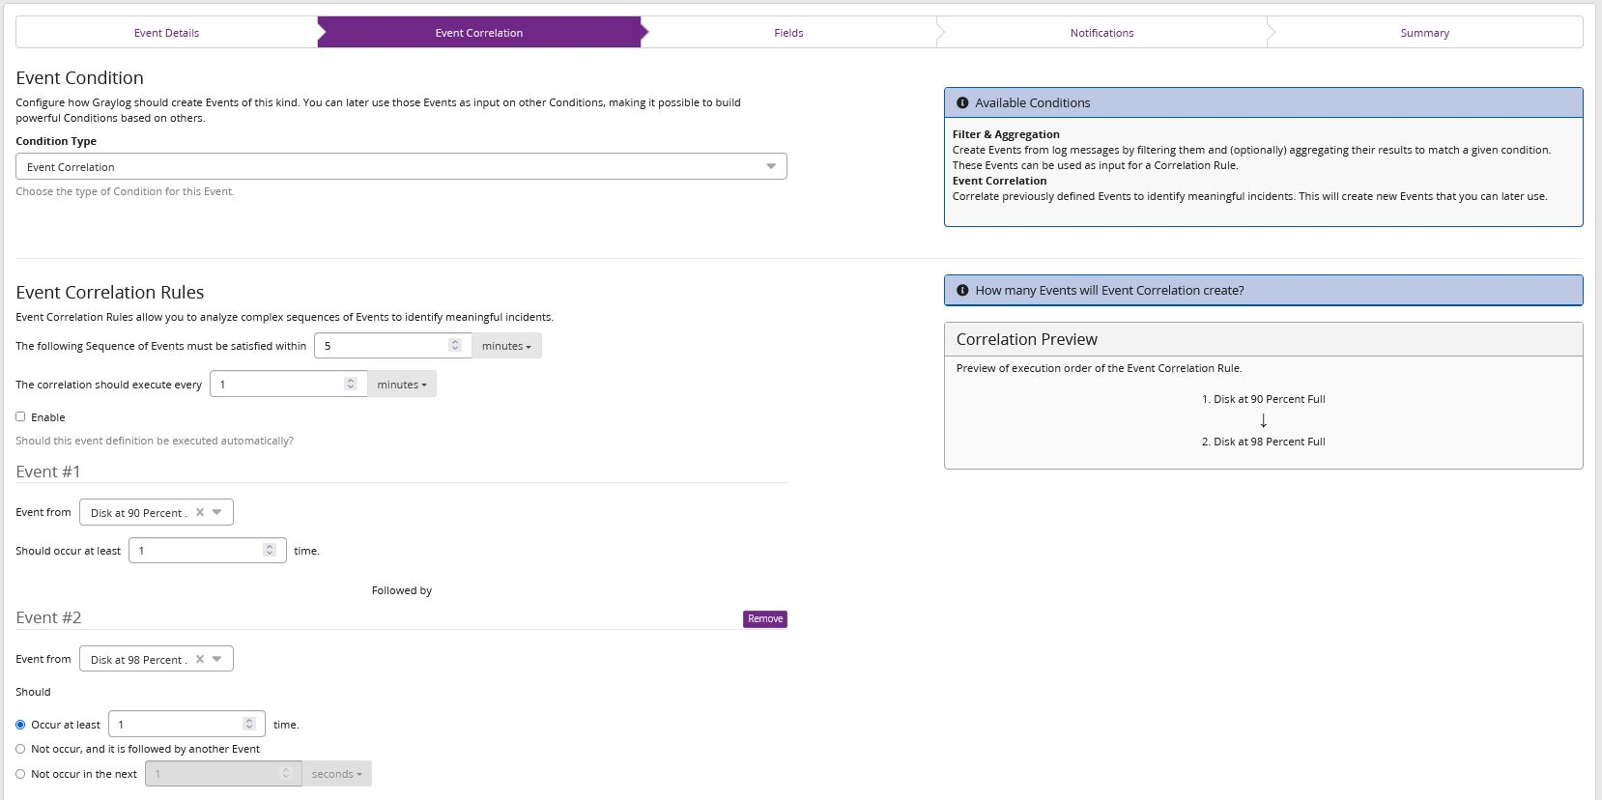
INTRODUCTION TO GRAYLOG OPERATIONS
Notes:
In-product screenshot of event correlation engine

Slide 10

Lightning-fast investigations
Every second counts
Search volumes of log data in milliseconds
No proprietary query language needed
The context you need at your fingertips
INTRODUCTION TO GRAYLOG OPERATIONS
Notes:
Graylog Operations is built for speed - from building search queries in minutes to executing those queries in milliseconds, we cut down on investigation time so you can reduce time to response and lower risk. The additional context provided by normalizing log data can further assist in speeding up investigations.

Slide 11
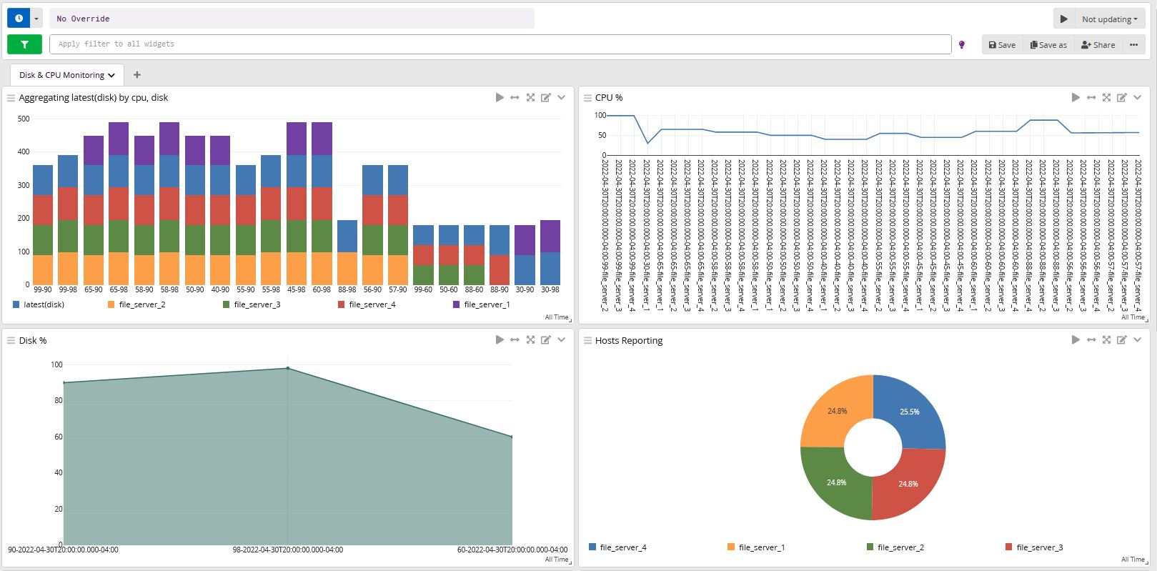
INTRODUCTION TO GRAYLOG OPERATIONS
Notes:
In-product screenshot context received via data enrichment/visualization.

Slide 12



SECTION NAME
All-in-one log management and affordability
The cost of your log management solution shouldn’t make you leave data out
License
Annual Subscription
Competitive Price Point
Self-Managed or Cloud Deployment
Scalable Architecture Minimizes Hardware Needs
Hardware
People
Ease of Use Increases Productivity
Product Capabilities For All Skill Levels
INTRODUCTION TO GRAYLOG OPERATIONS
Notes:
And last, but certainly not least - all of this adds up to a budget-freeing TCO that allows for you to use Graylog Operations to its full potential. Graylog Operations is priced so you can send all your logs and receive maximum visibility into your IT environment.

Slide 13




Single-pane-of-glass log management solution
Increased visibility across your IT environment
Graylog Operations
DELIVERS
Search volumes of log data in seconds
Get alerts for the issues that matter
Increase productivity with powerful automation
Improve key metrics like MTTD and MTTR
INTRODUCTION TO GRAYLOG OPERATIONS
Notes:
Let’s wrap up with a quick summary of what we just covered. Graylog Operations delivers:
Graylog Operations is a log file visualization and management solution designed to help you take raw log data and turn it into actionable insight that can be used to more easily troubleshoot problems and optimize IT performance
Using the powerful built-in search engine in Graylog Operations, you can quickly find the log entries needed in a visual format to aid in troubleshooting
Graylog Operations comes equipped with a powerful, customizable alert engine along with delivery options including email notification, the triggering of an external script, and more.
Configuring alerts within Graylog Operations can alleviate productivity-reducing alert noise and give you confidence that alerts received are legitimate issues that require investigation, and the ability to offer streamlined SLAs
With customized alerts that you can rely on, Graylog Operations can you improve key metrics like mean time to detection (MTTD) and mean time to response (MTTR)

